Slide 1
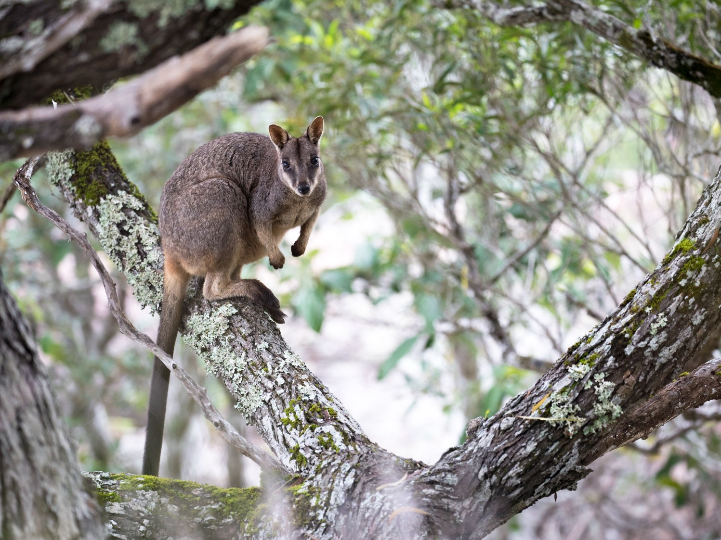
BIOL365: Marine and Terrestrial Ecology
Practical 2: Access genetic data from GenBank
James Dorey, Damien Esquerré, and Phil Byrne

Slide 2
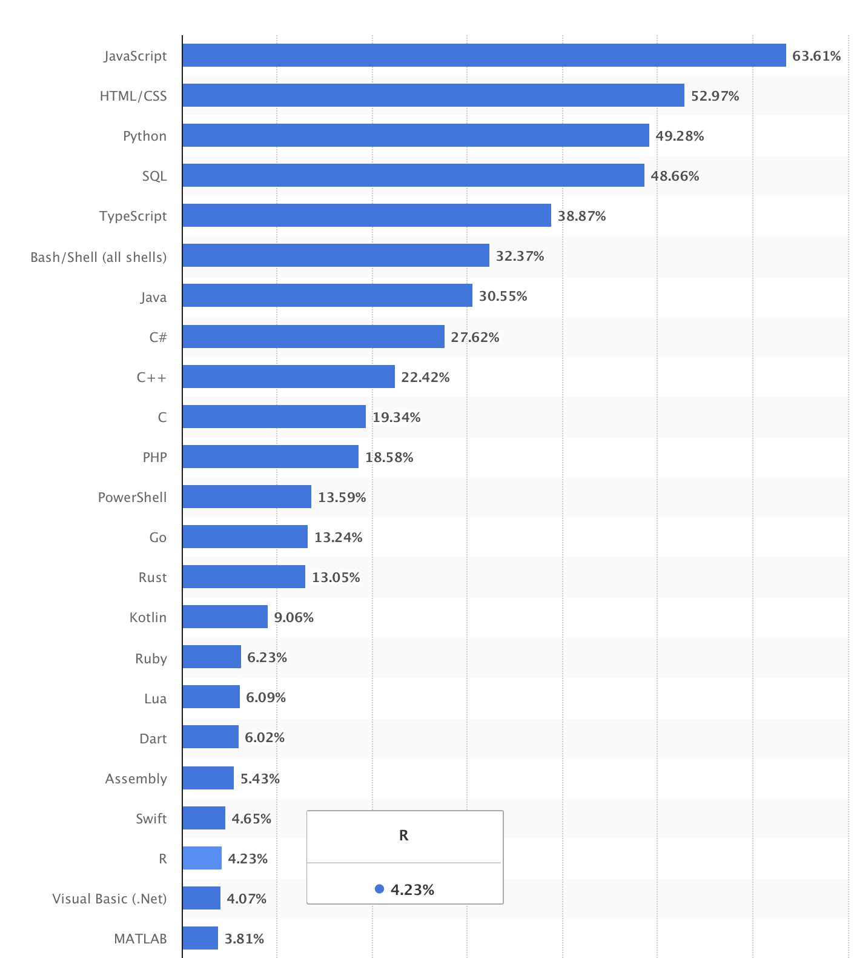
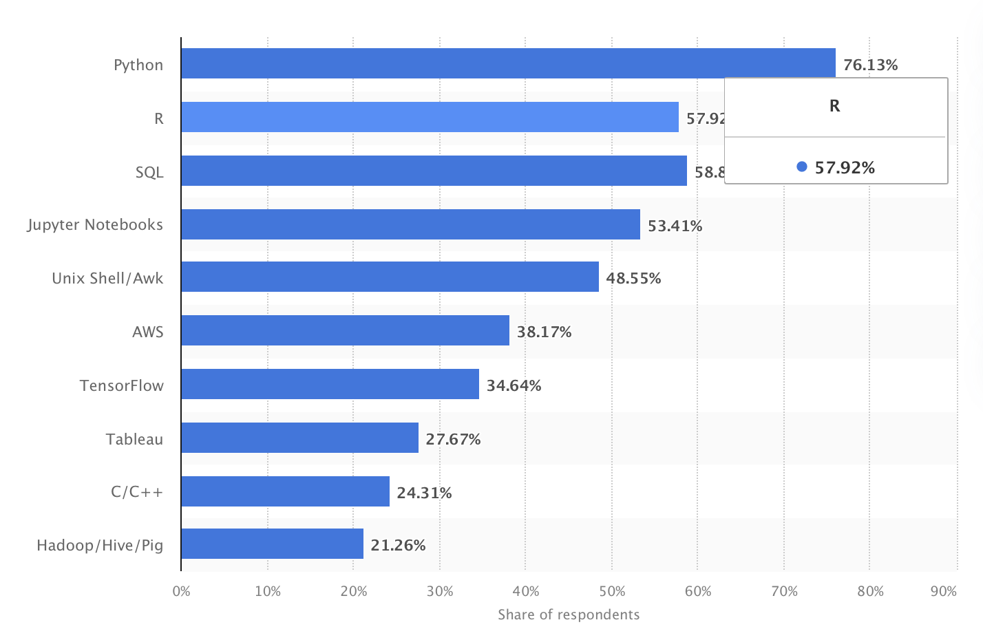
Intro to coding
Most used programming languages
among developers worldwide as of 2023
LinkedIn's most wanted data science
skills in United States as of April 2019
58%
R is one of the most-commonly used
Data Science skills
Perhaps most common in ecology and evolution
ChatGPT says: R > Python > MATLAB > Julia
4%

Slide 3
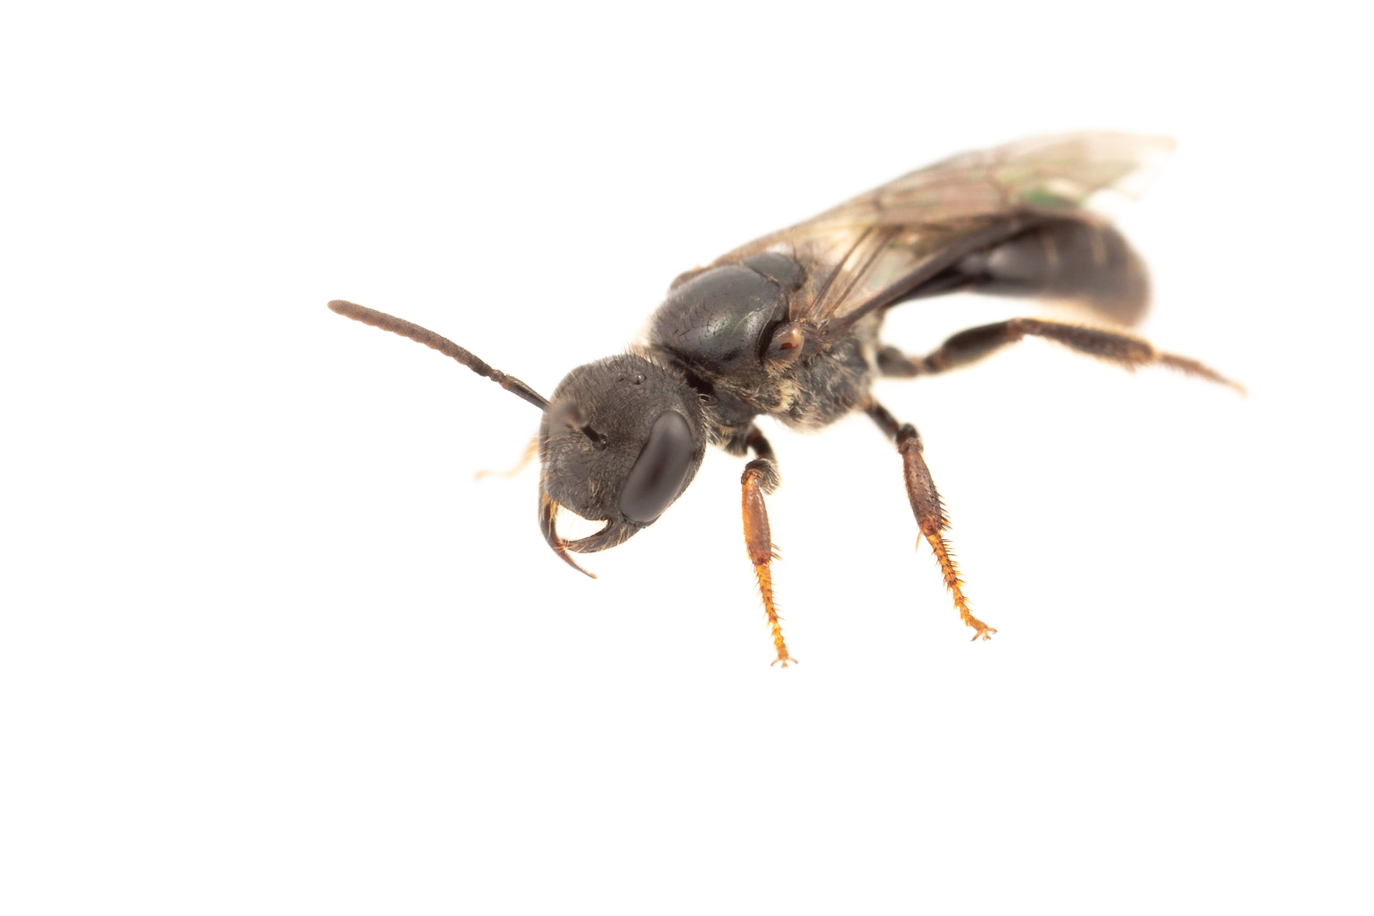
Intro to R
S language developed in 1976 (was commercial $)
R released (FREE) in 1995
stable version in 2000
RStudio released 2011
What makes R powerful?
Open source and free
Developers (>21,000 packages)
A huge amount of help and support
Runs on Mac, PC, Linux
Reproducible

Slide 4
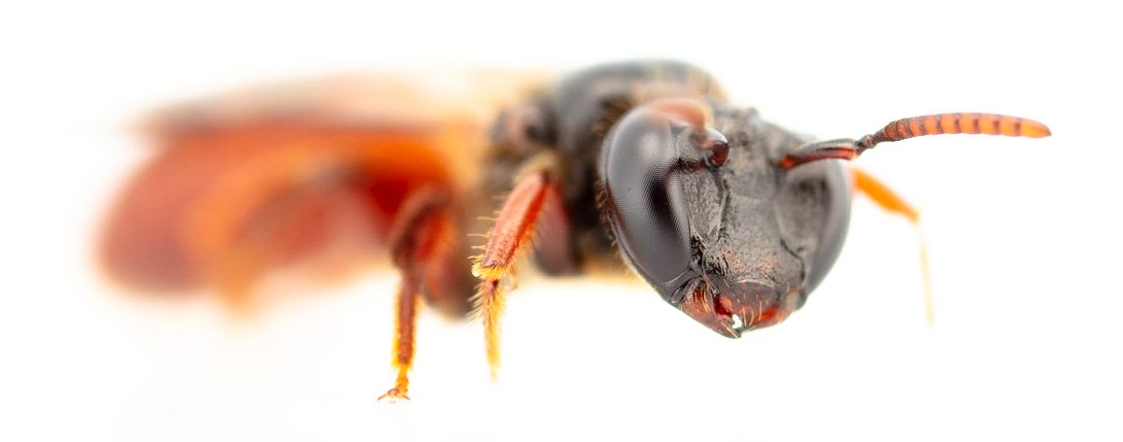
Intro to base R
Base R (and the default packages)
base
compiler, datasets, grDevices, graphics, grid, methods, parallel, splines, stats, stats4, tcltk, tools, translations, and utils
This is what you get when you start R

Slide 5



Intro to CRAN+
There’s more to be had!
CRAN
Has >21,000 packages
Run by volunteers
Very strict upload policies — Tell me why
Bioconductor
Especially for GENETICS R packages
3,700 packages
GitHub
Wild west
??? Packages
Great tool

Slide 6
base R syntax
Comments — these are note read by R
# text
Assigning variables
isNowThis <- This
isNowThis = This (usually only used in functions)
Data types
Numeric (1.23 or 9023.12)
Logical (TRUE or FALSE)
Character (“Sup nerds?”)
Vectors (strings of data types)
numericVector <- c(1, 2, 3, 4, 5)
logicalVector <- c(TRUE, FALSE, FALSE)
characterVector <- c(“Sup”, “nerds”)

Slide 7
base R syntax
Lists
myList <- list( name = “James”, topic = “BIOL365”, Week = 2)
Data frames
myDataFrame <- data.frame( "column1" = c(1,2,3), "column2" = c("a", "b", "c"))

Slide 8
base R syntax
Extracting data
We can take an element from a vector by position
characterVector <- c(“Sup”, “nerds”)
characterVector[2] = “nerds”
We can take an element from a data frame by position or name
myDataFrame <- data.frame( "column1" = c(1,2,3), "column2" = c("a", "b", "c"))
By row myDataFrame[1,] = column1 column2 1 a
By column myDataFrame[,1] = 1, 2, 3
Or both myDataFrame[1,1] = 1
By column name myDataFrame$column1 = 1, 2, 3

Slide 9

The tidyverse

Slide 10
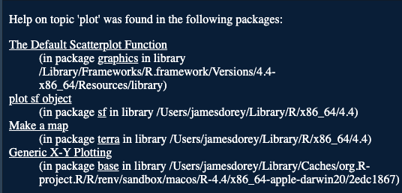
A quick note
library()
Makes your package active
Package::function()
Negates the need for a library call
Makes certain that you’re using the right package

Slide 11
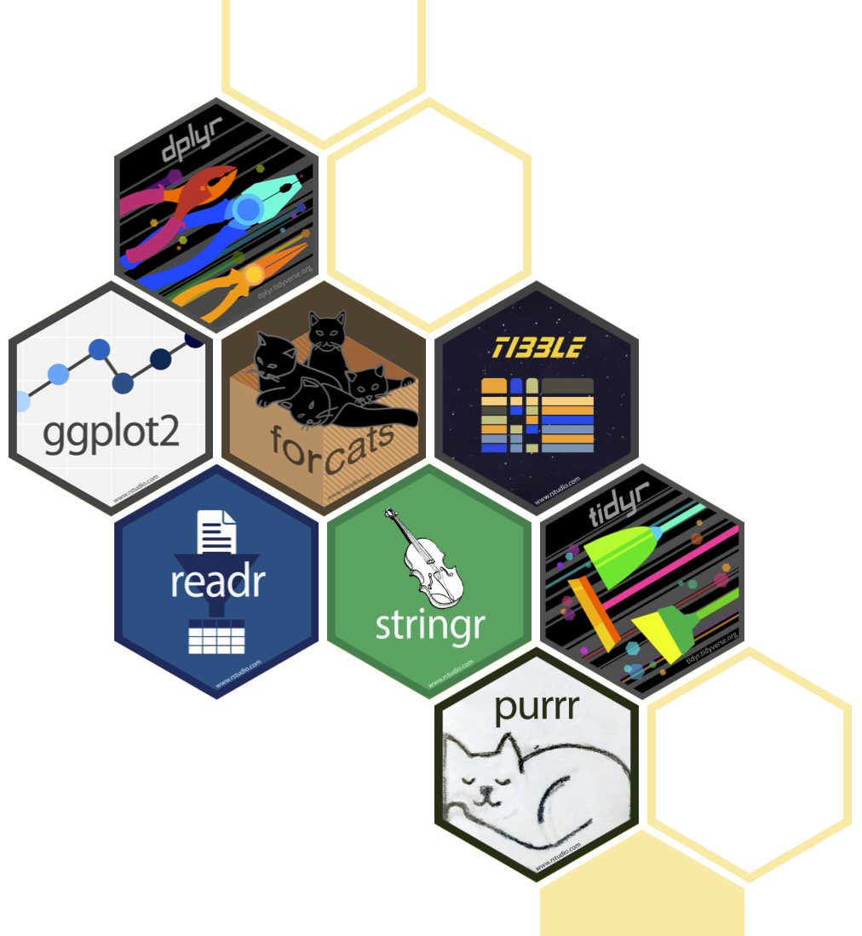
Intro to the tidyverse
A suite of packages for data science
“The tidyverse is an opinionated collection of R packages designed for data science.”
In my opinion, tidyverse is easier to code like a human being
Often, tidyverse is faster than base R (but, it’s not the fastest R package out there)

Slide 12

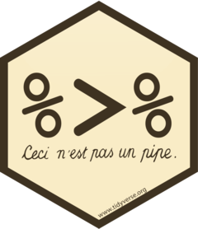
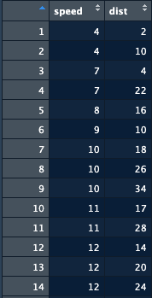
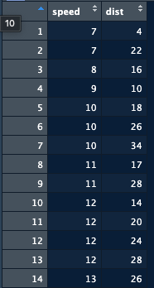
Intro to the tidyverse
As much as genetics, I want to teach you DATA MANAGEMENT!
dplyr example:
base:
baseFilter <- carsTibble[carsTibble$speed >= 5, 1:2]
…48 rows
Dplyr:
dplyrFilter <- dplyr::filter(carsTibble, speed > 5)
Dplyr + magrittr:
dplyrFilter <- carsTibble %>%
dplyr::filter(speed > 5)
…50 rows

Slide 13
Seminars
If you have not picked two seminar topics, you must come and speak to use to make your choice this week.

